Slide 1
Problem Solving and Critical Thinking

Slide 2
Flex your Brain Muscles
Push ups for the brain
Uncomfortable, but worth it
Practice makes perfect

Slide 3
What We’ll Cover Today
General steps
Problem solving
Critical thinking
Data Science Specifics
Organization
Flowcharting
Problem solving checklist
When to ask for help

Slide 4
General Problem Solving and Critical Thinking

Slide 5
Steps to Problem Solving
Define the problem
Set a goal – what do you want to achieve by solving the problem?
Brainstorm possible solutions
Rule out any bad options
Evaluate pros and cons of options
Identify and choose the best solution
Use your solution
Evaluate your solution

Slide 6
Question Everything!
What information about this problem do you already have?
How do you know the above information?
What is your goal and what are you trying to discover, prove, disprove, support or criticize?
What might you be overlooking?
Write down / say out loud the answers
Use someone else as a sounding board

Slide 7
To summarize, think through:
What do I have?
What do I need?
How do I get there?
Have
???
(How)
Need
Given information
Work you’ve already done
???
Solution

Slide 8
Problem Solving in Data Science

Slide 9
Code for Success
Do the smallest, simplest piece you can at a time
Check to ensure your code worked
Add another piece
This lets you pinpoint what went wrong

Slide 10
Organize your Code
Make notes so you know what each step is doing for next time
Break your work up into sections
Import packages/libraries
Data import
Wrangling
Analysis, visualization
Code linearly – everything from start to finish should go in order
Remove code attempts that didn’t work
Save code by module, lesson, and topic

Slide 11
Create a Flowchart
Visually display the problem you’re on
Make concrete an abstract issue
Import Package/Library
Import Data
Manipulate Data
Use Function

Slide 12
Work Backwards
Import Package/Library
Import Data
Manipulate Data
Use Function

Slide 13
Problem Solving Checklist

Slide 14
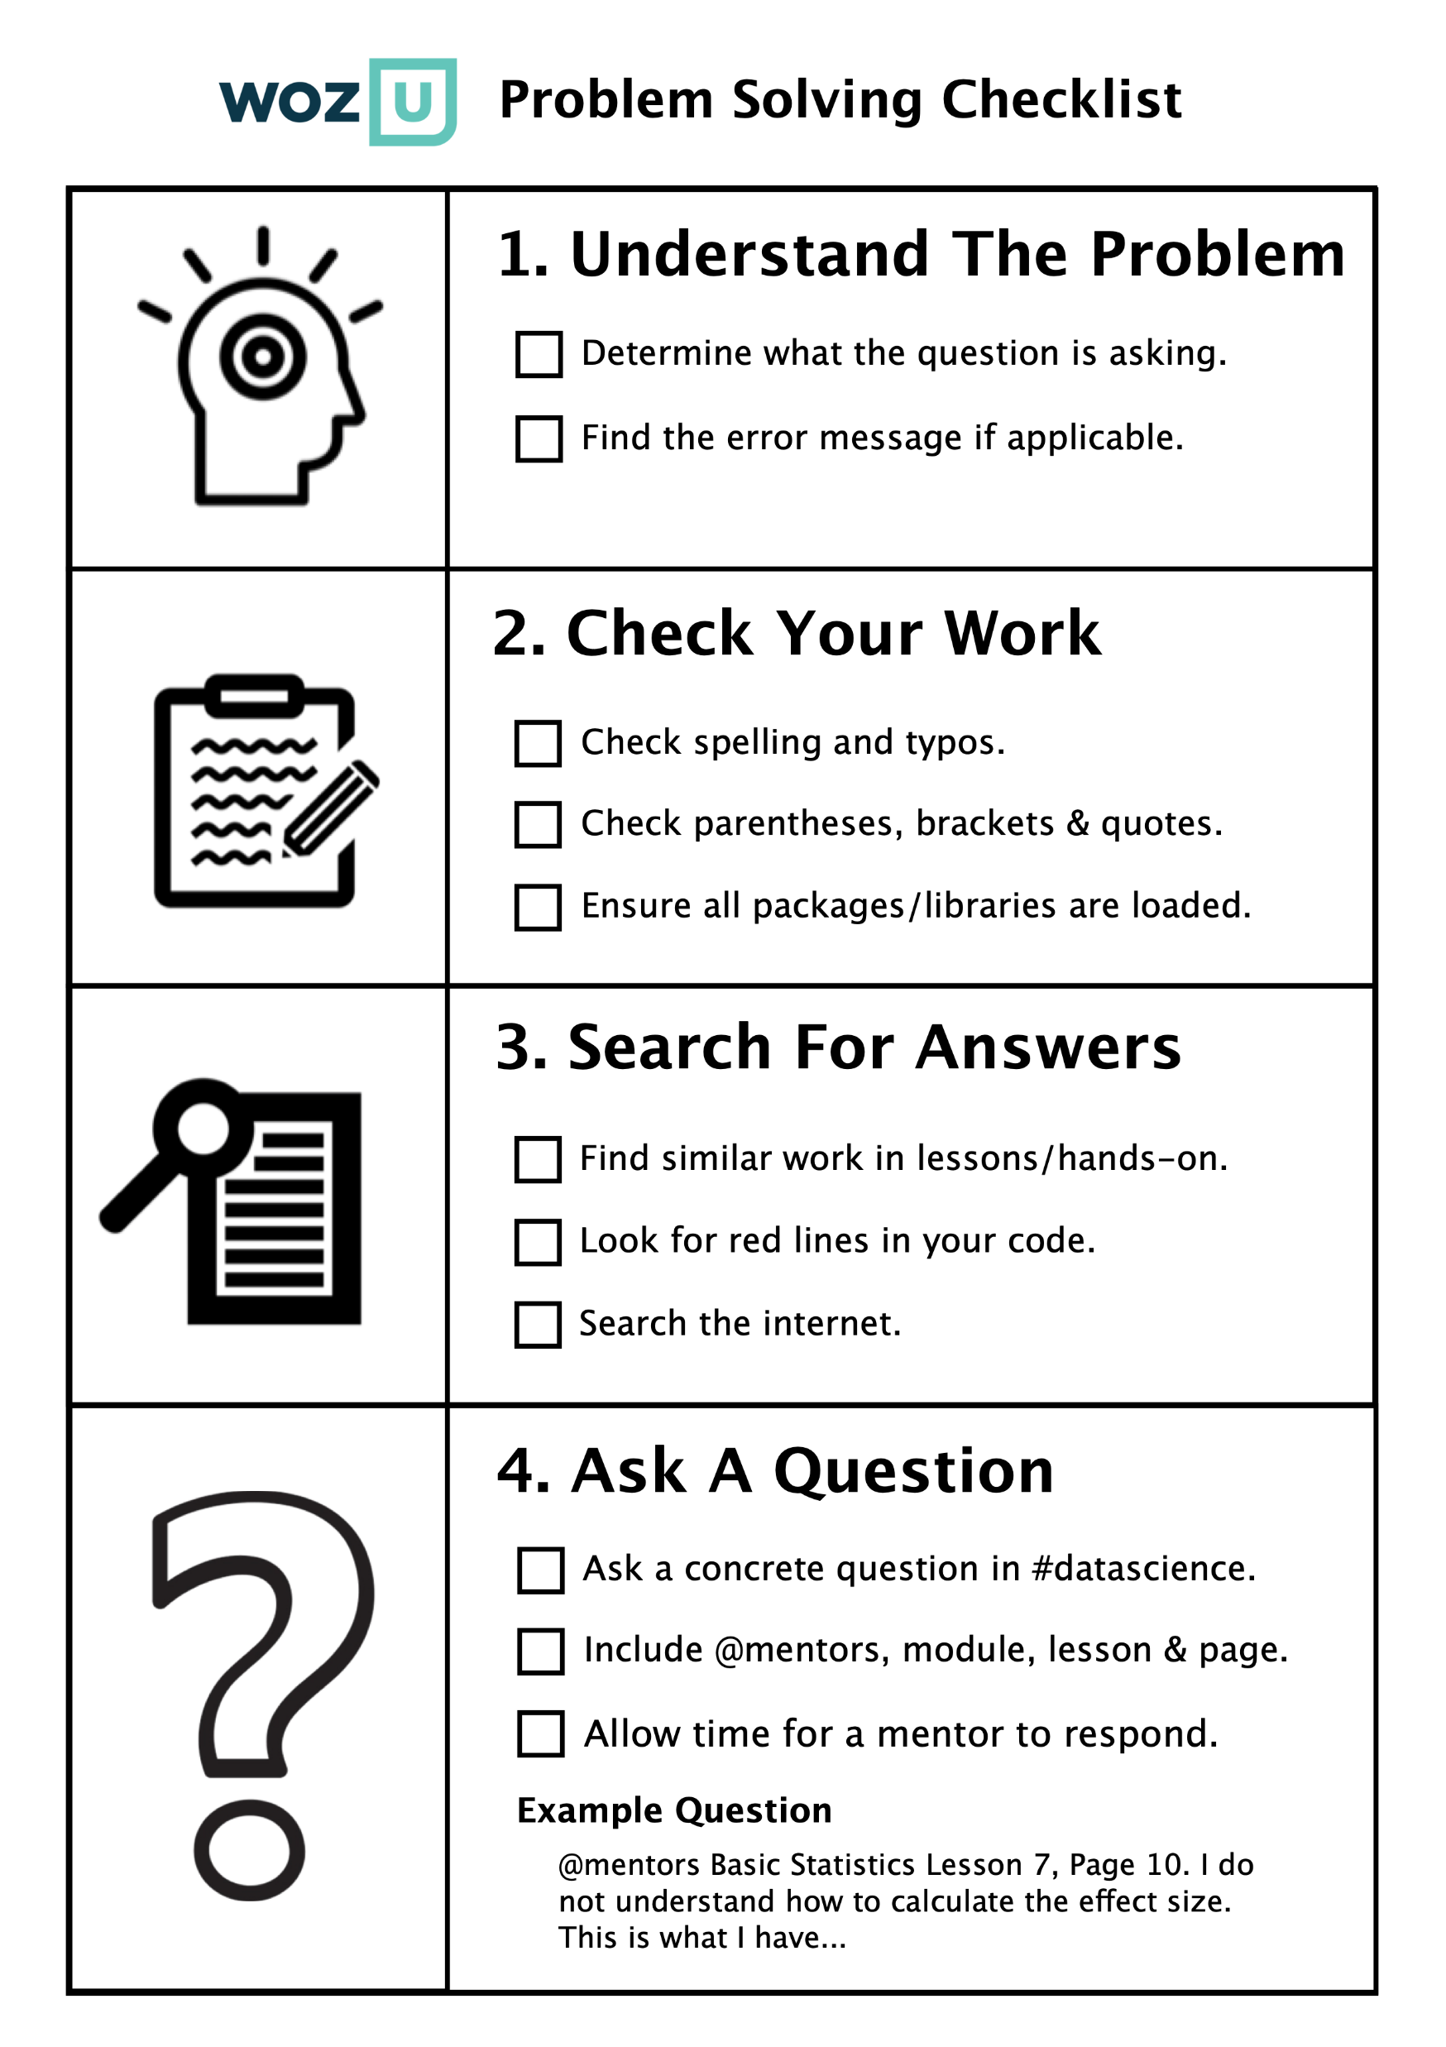

Slide 15
Determine What the Question is Asking
Ask yourself:
What is this question asking me to do?
Break it into the smallest parts you can
Figure out the parts you already have

Slide 16
Find Similar Work in Lessons / Hands On
Ask yourself:
Have I seen anything else like this in my lessons?
Go through page by page in the lesson
Ask yourself:
Have I done anything else like this in a hands-on or an example?
Pull up homework / follow along files

Slide 17
Compare with Similar Things
Place your current problem and past work side by side
Ask yourself:
What should be the same?
What is different about the questions/problems?
What is the part I should change?
Copy and paste similar code and modify

Slide 18
Check for Typos and Correct Spelling
Ask yourself:
Have I spelled everything correctly?
Is my spelling consistent?
Object to object
Function to function
Libraries/packages
Data

Slide 19
Check Punctuation
Ask yourself:
Have I closed all of the following?
Parentheses ( )
Brackets [ ]
Curly brackets { }
Single quotes ‘
Double quotes “
Count how many open versus closed
Determine where each open one gets closed
R will give you a red squiggly when these are wrong

Slide 20
Ensure All Packages / Libraries are Loaded
When using R, ask yourself:
Have you installed and loaded all the libraries you need?
When using Python, ask yourself:
Have you installed and loaded all the packages you need?

Slide 21
Search the Internet
Information to include in search:
Error message or general problem
Language
Specific packages – ggplot etc.
Know when responses are too far over your head
Good resources to choose:
Data to Fish
Towards Data Science
Geeks for Geeks
W3 Schools
R Bloggers
Stack Overflow*

Slide 22
Ask a Concrete Question
Write out a concrete question for staff
“I don’t understand this concept. Does this mean X?”
“This part of the project does not work, and I got X error.”
Include screenshots or code when you can
Being specific helps:
YOU better understand
US answer you faster and more completely
Try problem solving for AT LEAST 10-15 minutes
If you’re still stuck, frustrated, or angry, then ask!

Slide 23
Questions?

